Slide 1

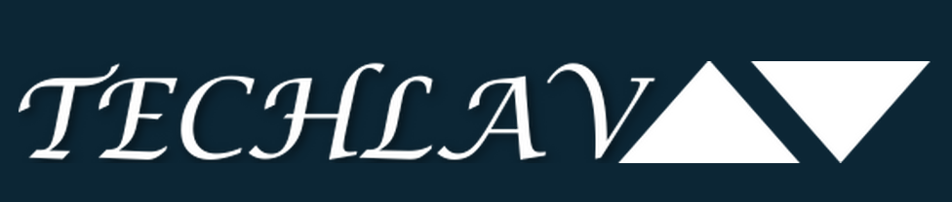

Task Allocation for Cooperative Multi-agent Systems
ACCESS
Laya Shamgah
PhD Student
Advisor:
Dr. Karimoddini

Slide 2
Outline
ACCESS
1
Introduction to Cooperative Control
3
Problem of Task Allocation
4
Existing Approaches
Future Plan
5
Applications
2

Slide 3
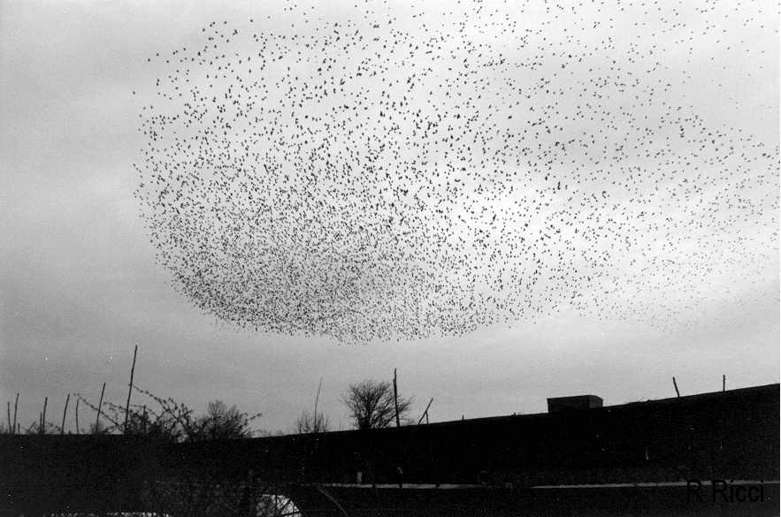

Examples of Cooperation in Nature
ACCESS
Schooling of Fish
Flocking of Birds

Slide 4
Advantage of Cooperative Control
ACCESS
Cooperation is being used to accomplish some common purpose that is greater than the purpose of each individual.
ADVANTAGES
Faster task completion
More flexible solution
Completion of the task impossible for single agent
Increased robustness

Slide 5
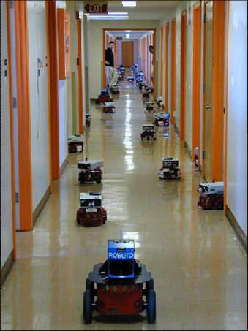
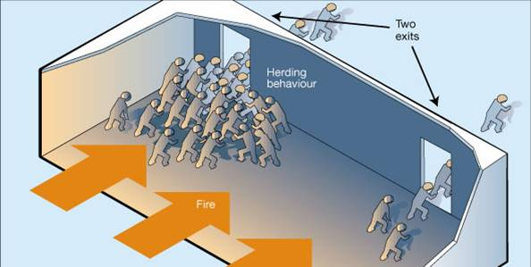
Applications of Cooperative Control
ACCESS
Crowd Dynamics and Building Egress
Mobile Robot Networks

Slide 6
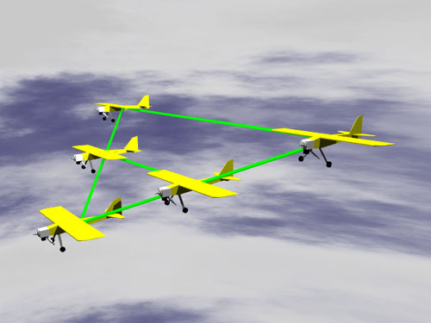
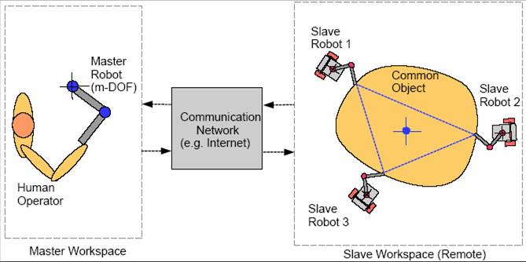
Applications of Cooperative Control
ACCESS
Autonomous Formation Flying and UAV Networks
Multi-Robot Remote Manipulation

Slide 7
Challenges of Cooperative Systems
ACCESS
Challenges
Issues
Dynamic events
Changing task demands
Resource failures
Presence of adversaries
Limitation in environment (Limited time, energy, computation, communication
Limitation in individuals capabilities (Limited sensing and mobility)
Formulation, description, decomposition and allocation of tasks
Communication languages and protocols
Coherence, Stability behavior, …
Task allocation

Slide 8
Task Allocation Problem
ACCESS
Which individual should execute which task in order to cooperatively achieve the global goal?
better TA more efficient performance
Complexity arises with:
Larger team sizes
Greater heterogeneity of robots and tasks

Slide 9
Task Allocation Problem
ACCESS
Global Task
Subtask1
Subtask3
Subtask2
Agent 1
Agent 2
Agent 3

Slide 10
Different Types of Tasks
ACCESS
Single
Multiple
Discrete
Continuous
Time-scaled
Static
Dependent
Independent

Slide 11
Task Allocation Approaches
ACCESS
Self-organizing approaches
Threshold-based methods
Game theoretical methods
Planning-based approaches
Market-based methods
DES task-decomposition methods

Slide 12
Task Allocation Approaches
ACCESS
Self-organizing approaches
DES task-decomposition methods
Market-based methods
Planning-based approaches
Game theoretical methods
Threshold-based methods

Slide 13
Self-organization Approaches
ACCESS
Self-organizing systems rely on group behaviors to emerge from group interactions and individual decision making based on local data.
Local communication
Limited communication
Group interaction
Restricted individuals capabilities
Self-interested agents
Feasible individual decision
No centralized or decentralized control

Slide 14
Self-organization Approaches
ACCESS
Global Task
(1) Decomposition
Subtask1
Subtask3
(2) Decision making
Subtask2
(3) Task allocation
Decision process
Decision process
Decision process
Agent 1
Agent 2
Agent 3

Slide 15
Task Allocation Approaches
ACCESS
Self-organizing approaches
Threshold-based methods
Game theoretical methods
Planning-based approaches
Market-based methods
DES task-decomposition methods

Slide 16
Threshold-based TA Methods
ACCESS
Decision process
if
decision criteria > threshold
agent picks the task
Agent 1
Decision to select a particular task depends on:
Individual’s perception of a task
Individual’s response threshold for the task:
Threshold types:
Same fixed response threshold for all agents
Different fixed response threshold based on individuals capabilities or the configuration of the system
Adaptive response-threshold models change the thresholds over time

Slide 17
Problem Formulation
ACCESS
Robotic manufacturing shop-floor scenario:
Tasks:
Each task represents a machine capable of producing goods from raw materials.
The machines require regular maintenance work.
Together the production and maintenance work loads constitute the total workload or task urgency.
Individuals:
Represent the robots.
The robots repeatedly select tasks and if the robot is outside a fixed task boundary, it navigates towards the task. If the robot is within the task boundary it remains there until the end of the time step when a new (or the same) task is selected.

Slide 18
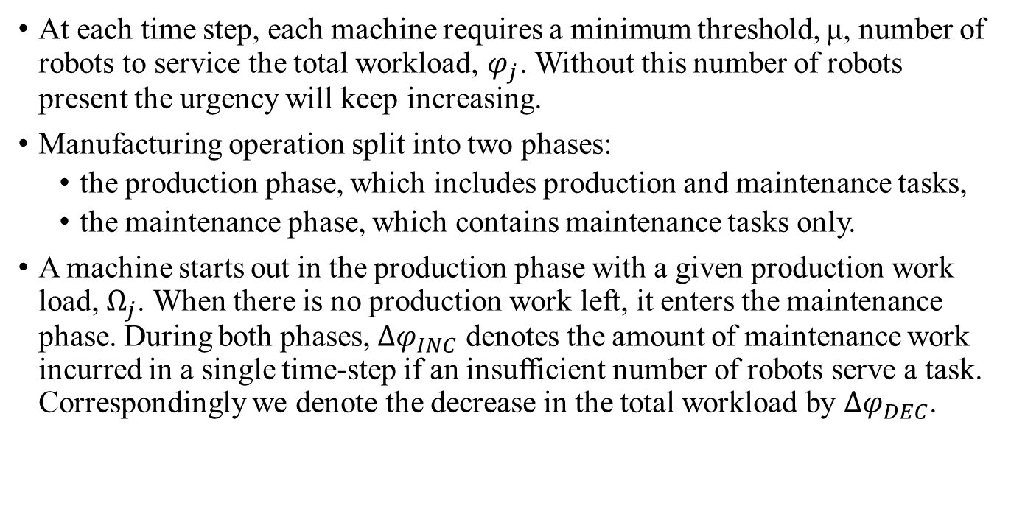
Problem Formulation
ACCESS
At each time step, each machine requires a minimum threshold, μ, number of robots to service the total workload, $φ_{j}$. Without this number of robots present the urgency will keep increasing.
Manufacturing operation split into two phases:
the production phase, which includes production and maintenance tasks,
the maintenance phase, which contains maintenance tasks only.
A machine starts out in the production phase with a given production work load, $Ω_{j}$. When there is no production work left, it enters the maintenance phase. During both phases, $Δφ_{INC}$ denotes the amount of maintenance work incurred in a single time-step if an insufficient number of robots serve a task. Correspondingly we denote the decrease in the total workload by $Δφ_{DEC}$.

Slide 19
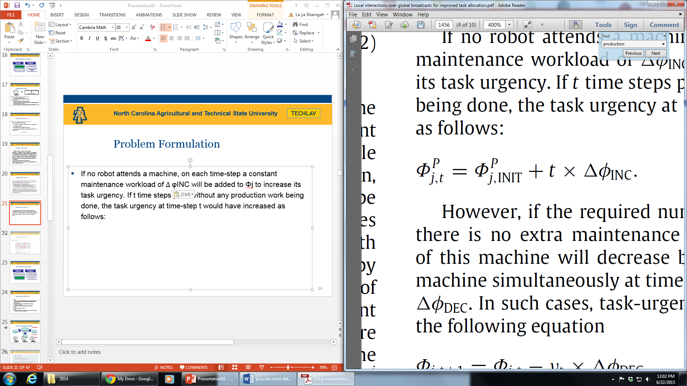
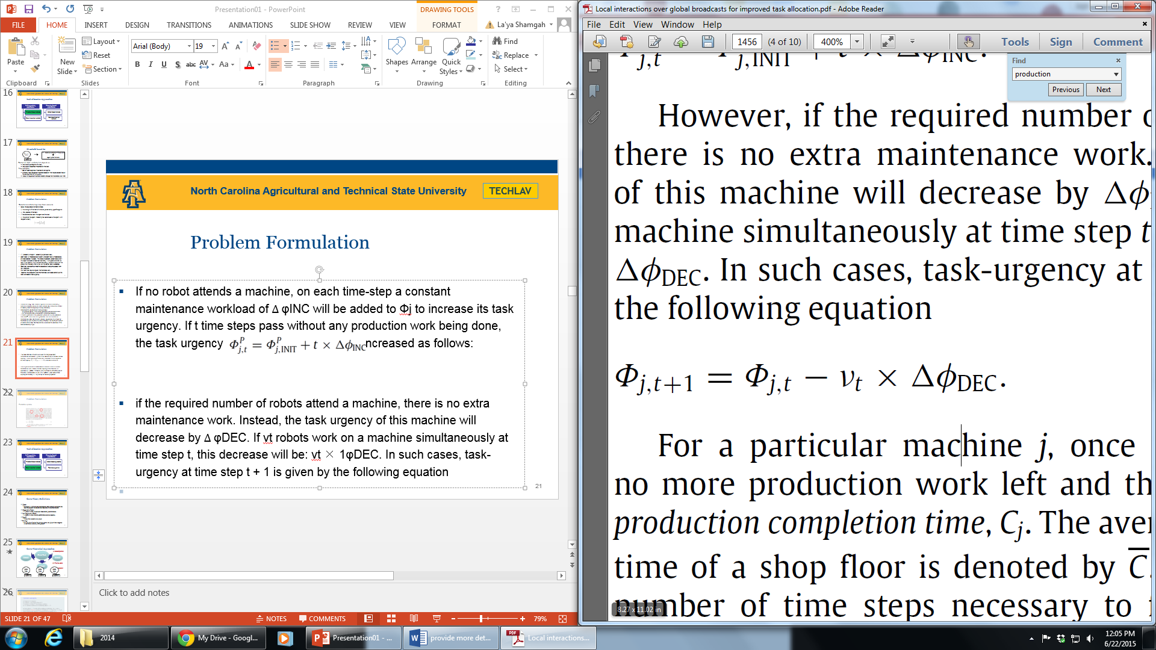
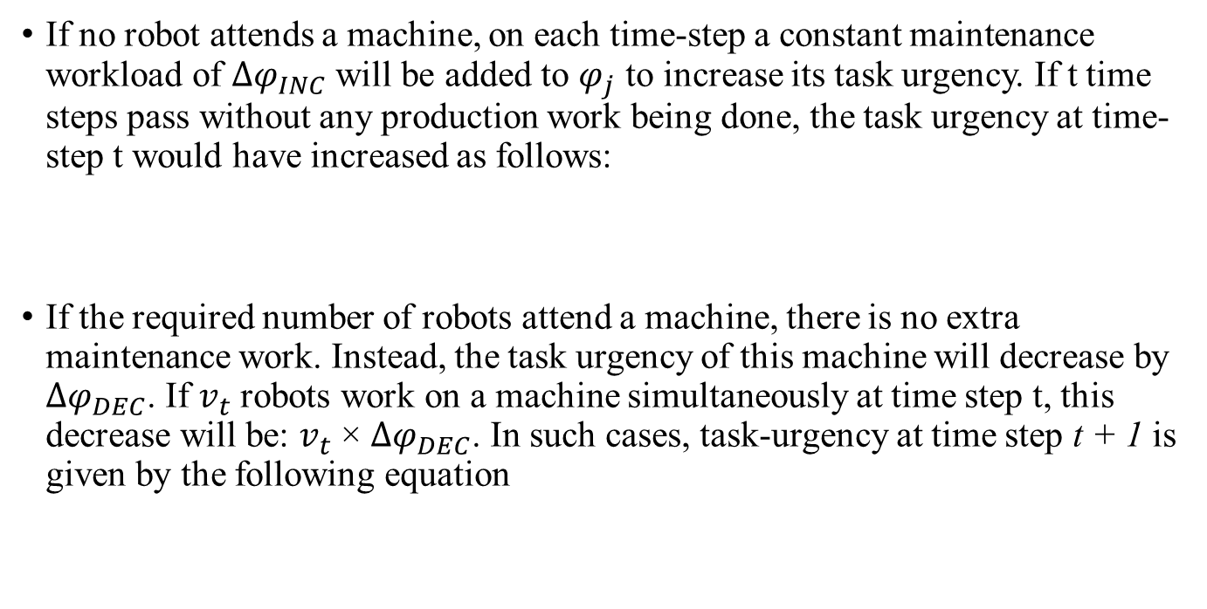
Problem Formulation
ACCESS
If no robot attends a machine, on each time-step a constant maintenance workload of $Δφ_{INC}$ will be added to $φ_{j}$ to increase its task urgency. If t time steps pass without any production work being done, the task urgency at time-step t would have increased as follows:
If the required number of robots attend a machine, there is no extra maintenance work. Instead, the task urgency of this machine will decrease by $Δφ_{DEC}$. If $v_{t}$ robots work on a machine simultaneously at time step t, this decrease will be: $v_{t}$ × $Δφ_{DEC}$. In such cases, task-urgency at time step t + 1 is given by the following equation

Slide 20
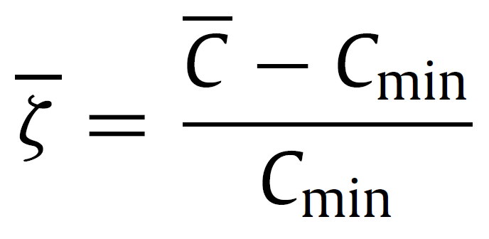
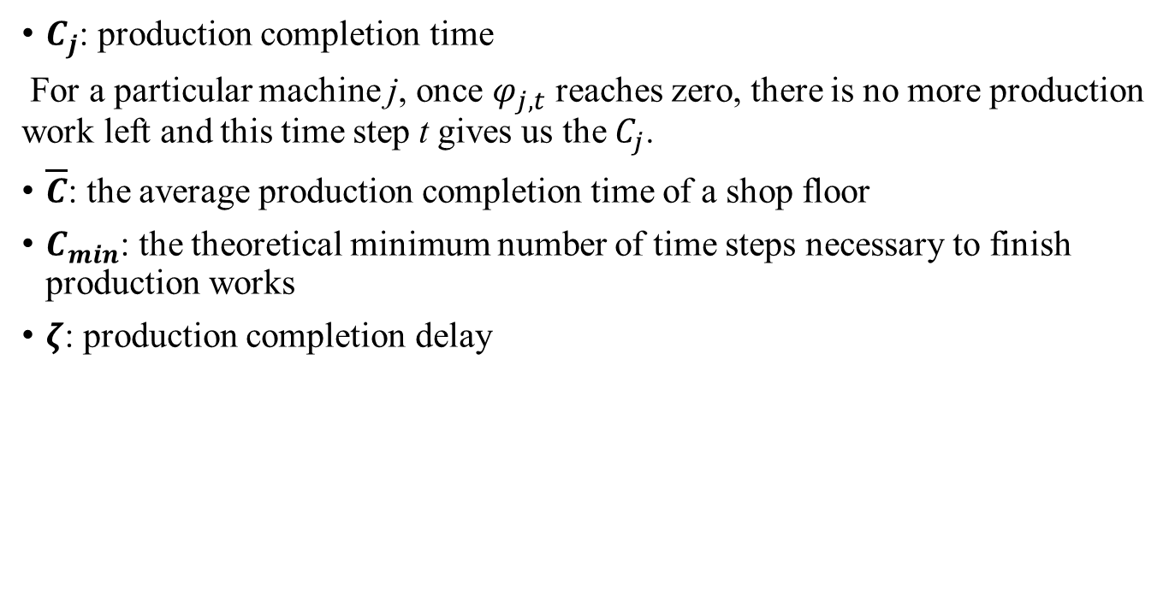
Problem Formulation
ACCESS
$C_{j}$: production completion time
For a particular machine j, once $φ_{j,t}$ reaches zero, there is no more production work left and this time step t gives us the $C_{j}$.
$\overline{C}$: the average production completion time of a shop floor
$C_{min}$: the theoretical minimum number of time steps necessary to finish production works
$ζ$: production completion delay

Slide 21
Task Allocation Approaches
ACCESS
Self-organizing approaches
Threshold-based methods
Game theoretical methods
Planning-based approaches
Market-based methods
DES task-decomposition methods

Slide 22
Game Theory Definitions
ACCESS
Game:
Situation in which players (participants) make strategic decisions that take into account the actions and reactions of the other players
Cooperative Game:
A game in which players can make binding commitments
Non-cooperative Game:
A game in which binding commitments are not possible
Payoff:
Value of an outcome to a player
Strategy:
Rule or plan of action for playing a game; one player’s best response to each action taken by other players

Slide 23
Game Theoretical Approaches
ACCESS
Global Task
(1) Decomposition
Subtask1
Subtask3
(2) Playing game
Subtask2
Game rules
Game rules
Game rules
(3) Task Allocation
Agent 1
Agent 2
Agent 3

Slide 24
Problem Formulation
ACCESS
The problem is modeled as a hedonic coalition formation game between the agents and the tasks that interact in order to form disjoint coalitions.
A coalition formation game is classified as hedonic, if
The payoff of any player depends solely on the members of the coalition to which the player belongs.
The coalitions form as a result of the preferences of the players over their possible coalitions’ set.

Slide 25
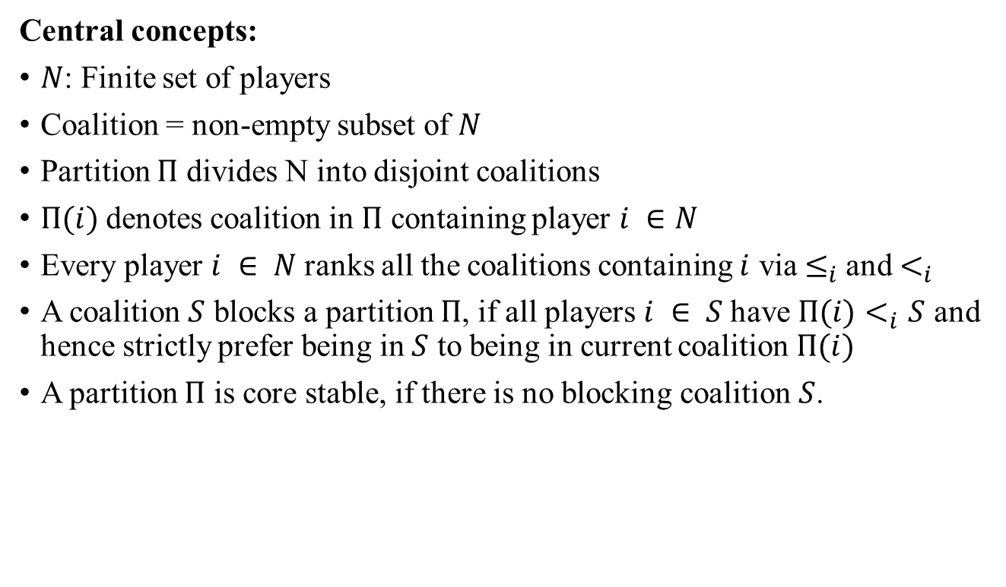
Coalitions in Hedonic Games
ACCESS
Central concepts:
$N$: Finite set of players
Coalition = non-empty subset of $N$
Partition $Π$ divides N into disjoint coalitions
$Π(i)$denotes coalition in $Π$ containing player $i ∈N$
Every player $i ∈ N$ranks all the coalitions containing $i$ via $≤_{i}$and $<_{i}$
A coalition $S$ blocks a partition $Π$, if all players $i ∈ S$have ${Π(i)<}_{i}S$ and hence strictly prefer being in $S$ to being in current coalition $Π(i)$
A partition $Π$ is core stable, if there is no blocking coalition $S$.

Slide 26
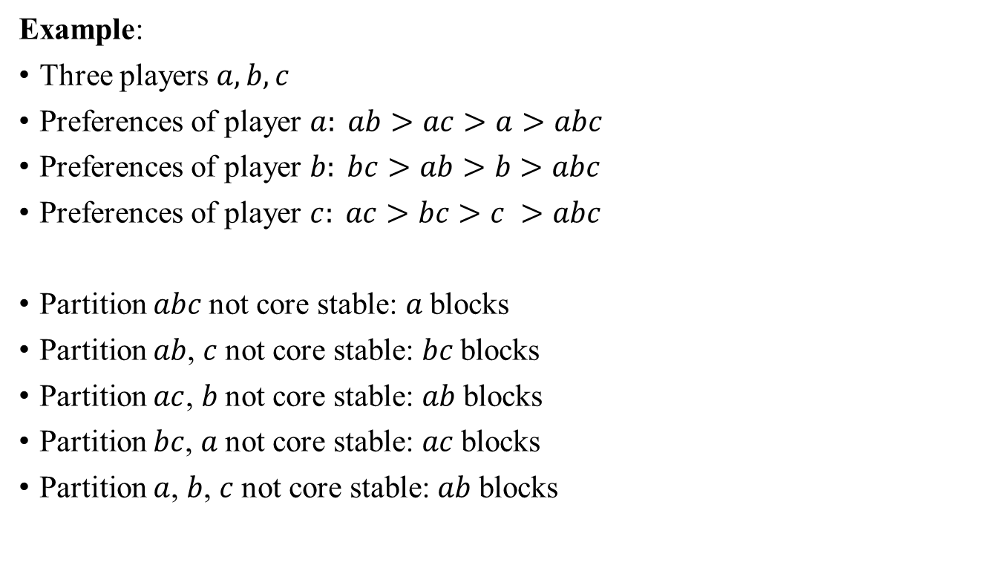
Coalitions in Hedonic Games
ACCESS
Example:
Three players $a, b, c$
Preferences of player $a: ab>ac>a>abc$
Preferences of player $b: bc>ab>b>abc$
Preferences of player $c: ac>bc>c >abc$
Partition $abc$not core stable: $a$blocks
Partition $ab$, $c$not core stable: $bc$blocks
Partition $ac$, $b$not core stable: $ab$blocks
Partition $bc$, $a$not core stable: $ac$blocks
Partition $a$, $b$, $c$not core stable: $ab$blocks
This simple cyclic 3-player game does not allow a core stable partition.

Slide 27
Pros and Cons
ACCESS
Pros
Better scale-up than planning methods
Difficult to predict the exact behavior of Individuals
Cons
Rely less on modeling the environment, tasks and individuals
Make decision based on local data
Approaches mainly focus on single global tasks
Difficult to formally design, analyze and implement

Slide 28
Task Allocation Approaches
ACCESS
Self-organizing approaches
Threshold-based methods
Game theoretical methods
Planning-based approaches
Market-based methods
DES task-decomposition methods

Slide 29
Market-based Approaches
ACCESS
Global Task
(1) Decomposition
Subtask1
Subtask3
(3) Negotiation
(2) Offer and bid
Subtask2
bid2 > bid 1 , bid3
bid2
(4) Task allocation
bid1
bid3
Agent 1
Agent 2
Agent 3

Slide 30
Auction Types
ACCESS
1. Single-item auction:
only one item is offered
each participant submits a bid
auctioneer awards the item to the highest bidder
2. Multi-item auction:
multiple items are offered
participants can win at most one item apiece
3. Combinatorial auction:
multiple items are offered
each participant can bid on any combination of items.
Centralized
Decentralized
more centralized: more decentralized:
quality of solution speed of solution

Slide 31
Pros and Cons
ACCESS
Pros
Intuitive and straightforward for design and implement
Performance is reduced if number of agents arises
Cons
Strong communication requirements
Tradeoff between speed and quality

Slide 32
Task Allocation Approaches
ACCESS
Self-organizing approaches
Threshold-based methods
Game theoretical methods
Planning-based approaches
Market-based methods
DES task-decomposition methods

Slide 33
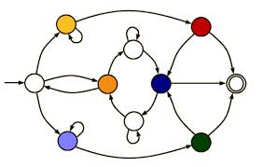

Discrete Event System
ACCESS
transitions
states
Mathematically convenient models
A flexibility to model various levels of detail and complexity
Allowing the modeling of uncertainty and dynamic (time changing) systems
Advances and variety in DES software
DES model
Complex mathematical model

Slide 34
DES Cooperative Control
ACCESS
Global Task
Formal task decomposition
Subtask1
Subtask3
Agent 1
Agent 3
Supervisory control1
Subtask2
Supervisory control3
Agent 2
(2) Controllers design
Supervisory control2

Slide 35
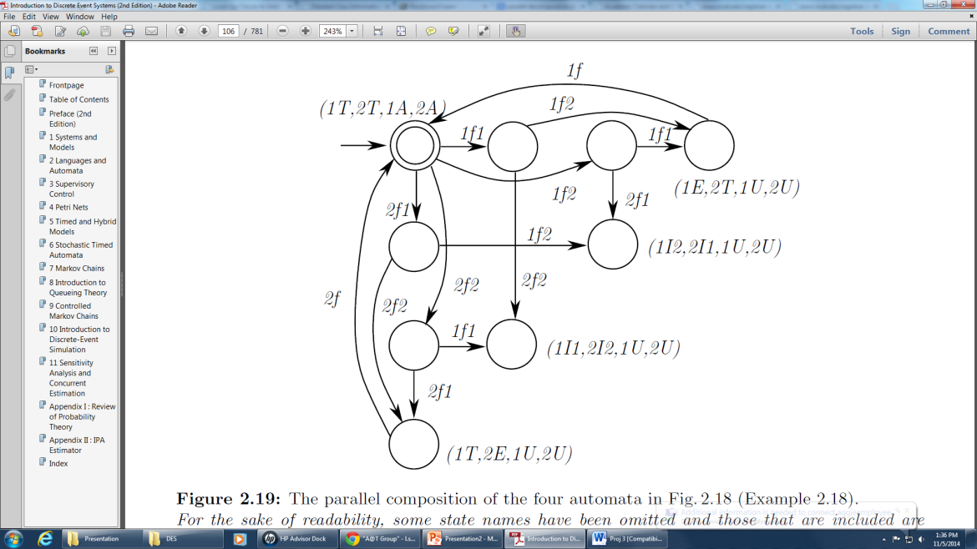
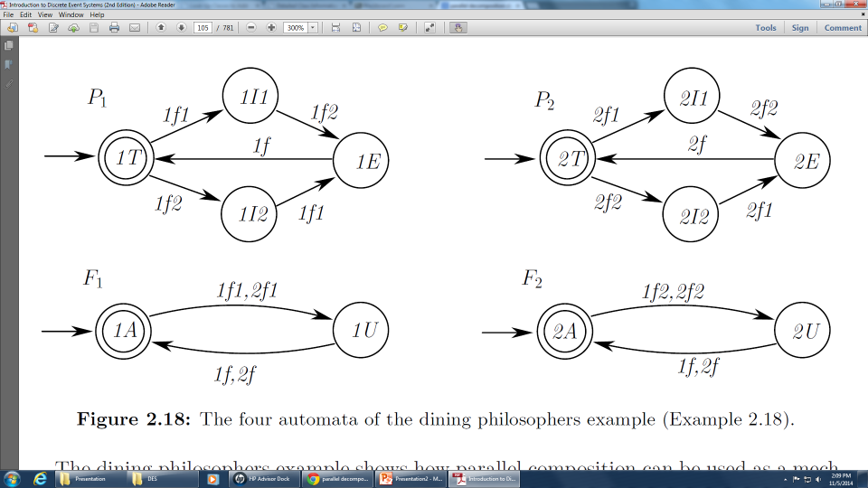
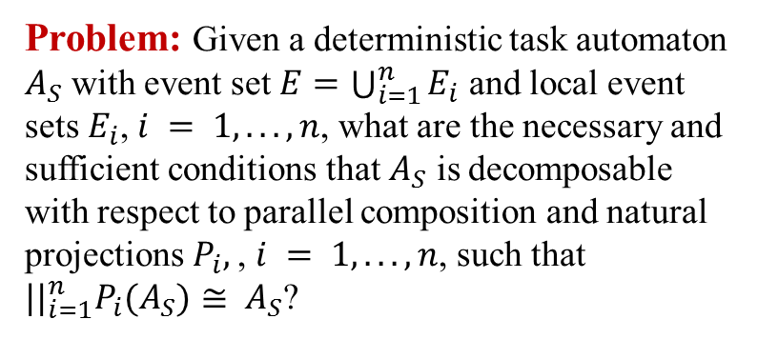
Problem Formulation
ACCESS
Global task
Subtasks
Individuals
Agent 1
Agent 2
Problem: Given a deterministic task automaton $A_{S}$ with event set $E=\bigcup_{i=1}^{n}{E_{i}}$ and local event sets $E_{i}$, $i = 1, . . . , n$, what are the necessary and sufficient conditions that $A_{S}$ is decomposable with respect to parallel composition and natural projections $P_{i},$, $i = 1, . . . , n$, such that ${||}_{i=1}^{n}P_{i}(A_{S})≅ A_{S}$?
Agent 3
Agent 4

Slide 36
Future Plan
ACCESS
Objective:
Obtain a decentralized, near-optimal and formal method for task allocation in search and coverage problems by combining task decomposition methods, DES models and game theory
Game theory
DES method
Formal procedure
Search and coverage problem

Slide 37
Why Search and Coverage Problem?
ACCESS
The use of robots in surveillance and exploration with minimal human supervision or intervention is gaining prominence.
As the number of vehicles increases it becomes increasingly difficult and even impossible for direct human supervision.
Typical applications include air- and ground-based mapping of predetermined areas for tasks such as surveillance, target detection, tracking, and search and rescue operations.
The use of multiple collaborative robots is ideally suited for such tasks.

Slide 38
Why DES?
ACCESS
Rapid evolution of computing, communication, and sensor technologies has brought about the proliferation of new dynamic highly complex systems (Example: computer and communication networks; automated manufacturing systems; air traffic control systems; advanced monitoring and control systems in automobiles or large buildings; intelligent transportation systems; distributed software systems, etc.)
DES has emerged to provide a formal treatment of such man-made systems
The challenge is to develop new modeling, analysis and design techniques, and systematic control and optimization procedures for this new generation of systems
Discrete event systems is a growing field that utilizes many interesting mathematical models and techniques.

Slide 39
Why Game Theory?
ACCESS
To jointly satisfy all three of the requirements of agility and robustness, timeliness and high-quality solutions for search and coverage problems
negotiation protocol allows to spread the computational burden of solving the problem across the agents in the system, which adds to the control mechanism’s robustness and the timeliness of its solutions
Better scale-up than other methods
Rely less on modeling the environment, tasks and individuals
Make decision based on local data

Slide 40
ACCESS
Thank you
Any Question?

Slide 41
Refrences-1
ACCESS
“A comprehensive taxonomy for multi-robot task allocation” G. Ayorkor Korsah, Anthony Stentz2 and M. Bernardine Dias.
“A Formal Analysis and Taxonomy of Task Allocation in Multi-Robot Systems” Brian P. Gerkey and Maja J. Mataric.
“Self-organized Task Allocation to Sequentially Interdependent Tasks in Swarm Robotics” A.Brutschy, G.Pini, C.Pinciroli, M.Birattari, and M.Dorigo.
“Local interactions over global broadcasts for improved task allocation in self-organized multi-robot systems” Md Omar Faruque Sarker, Torbjørn S. Dahl, Elsa Arcaute, Kim Christensend.
“Hedonic Coalition Formation for Distributed Task Allocation among Wireless Agents” W. Saad, Z. Han, T. Basar, M. Debbah, and A. Hjørungnes.
“Autonomous Vehicle-Target Assignment: A Game-Theoretical Formulation” Gürdal Arslan, Jason R. Marden, Jeff S. Shamma.
“Decentralized Dynamic Task Allocation Using Overlapping Potential Games” Archie C. Chapman1,∗, Rosa Anna Micillo2, Ramachandra Kota1 and Nicholas R. Jennings1.
“Market-Based Multirobot Coordination: A Survey and Analysis”, M. Bernardine Dias, Robert Zlot, Nidhi Kalra, and Anthony Stentz, Proccessings of IEEE.
“Cooperative Tasking for Deterministic Specification Automata”, Mohammad Karimadini, Hai Lin, Ali Karimoddini, Asian Journal of Control, Vol. 00, No. 0, pp. 1-14, Month 2008.

Slide 42
Refrences-2
ACCESS
“Decentralized Hybrid Formation Control of Unmanned Aerial Vehicles”, Ali Karimoddini, Mohammad Karimadini, Hai Lin, American Control Conference (ACC) June 4-6, 2014. Portland, Oregon, USA.
“Guaranteed global performance through local coordinations”, Mohammad Karimadini, Hai Lin, Automatica 47 (2011) 890–898.
“Market-Based Coordination of UAVs for Time-Constrained Remote Data Collection and Relay”, Ajorlou, A., Homaifar, A., Esterline, A., Moore, J. G., and Bamberger, R. J..
“Modeling and control of logical discrete event systems”, Ratnesh Kumar, Vijay K. Garg, SPRINGER SCIENCE+BUSINESS MEDIA, LLC.
“Introduction to Discrete Event Systems”, Christos G. Cassandras, Stéphane Lafortune, 2nd Edition, Springer.
“Cooperative Air and Ground Surveillance A Scalable Approach to the Detection and Localization of Targets by a Network of UAVs and UGVs”, BEN GROCHOLSKY, JAMES KELLER, VIJAY KUMAR, AND GEORGE PAPPAS , 16 IEEE Robotics & Automation Magazine 1070-9932/06/$20.00©2006 IEEE SEPTEMBER 2006
“Cooperative Control of UAVs for Search and Coverage”, Ali Ahmadzadeh, Gilad Buchman, Peng Cheng, Ali Jadbabaie, Jim Keller, Vijay Kumar , and George Pappas,

